Slide 1
Network and Communication
Module 1 Networking Principles and layered architecture
Dr. S.L.Jayalakshmi,
VIT Chennai

Slide 2
Text book
Textbook
Larry Peterson, Bruce S. Davie. Computer Networks: a system approach. 5th Edition.
Data Communications and Networking, Behrouz A. Forouzan, McGraw Hill Education, 5th Ed., 2012

Slide 3
Outline
Data Communication
Components
Networks
Line Configuration
Data Flow
Categories of Network
Characteristics
Pros & Cons of Network
Network Topologies
Internetwork and Internet

Slide 4
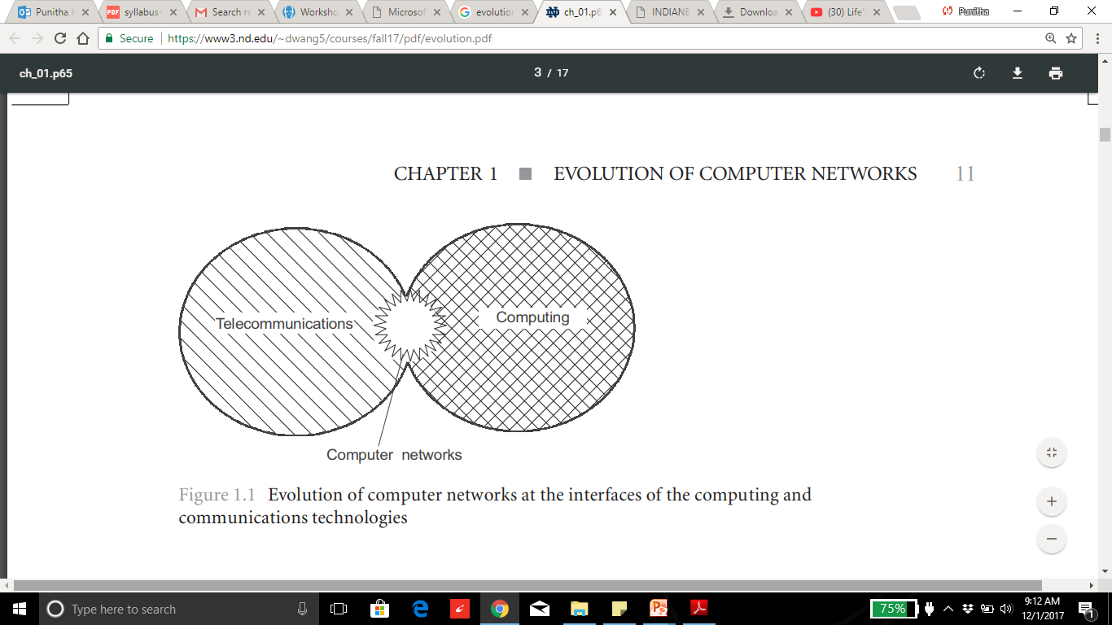
1. Evolution of network
Evolution of network

Slide 5
Evol….Roots of Computer networks
Computer networks: transmitting information over along distances. This implementation is done by various methods of data encoding and multiplexing in telecommunications systems.
Batch processing systems: 1950
Multiterminal systems: Prototype of the computer network(1960).

Slide 6
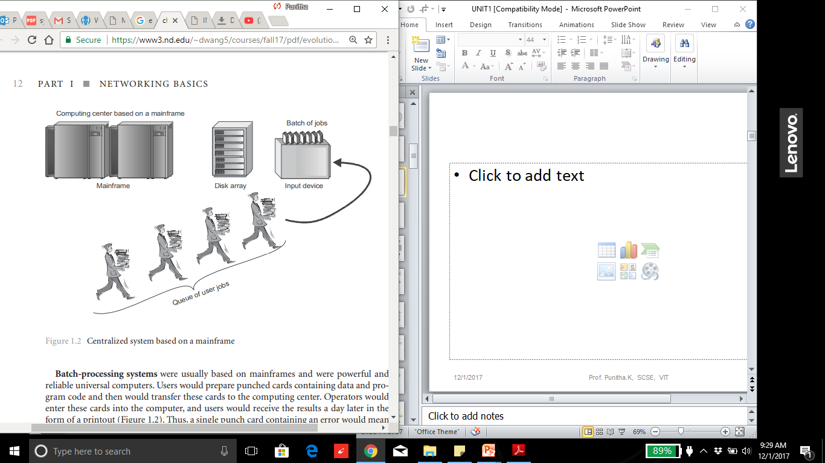
Batch processing systems

Slide 7
Disadvantage
Computer operators must be trained for using batch systems.
It is difficult to debug batch systems.
Batch systems are sometime costly.
If some job takes too much time i.e. if error occurs in job then other jobs will wait for unknown time

Slide 8
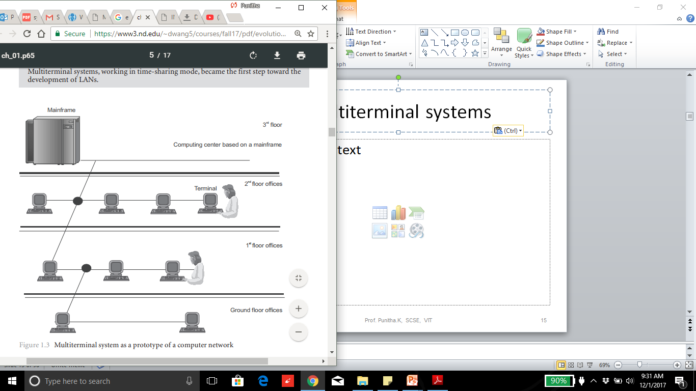
Multiterminal systems

Slide 9
Data Communication
Exchange of data
Via Transmission medium
Characteristics:
Delivery
Accuracy
Timeliness
Jitter
Notes:
The term telecommunication means communication at a
distance. The word data refers to information presented
in whatever form is agreed upon by the parties creating
and using the data. Data communications are the
exchange of data between two devices via some form of
transmission medium such as a wire cable.
Characteristics
1.Delivery. The system must deliver data to the correct destination. Data must be received by the intended device or user and only by that device or user. 2. Accuracy. The system must deliver the data accurately. Data that have been altered in transmission and left uncorrected are unusable. 3. Timeliness. The system must deliver data in a timely manner. Data delivered late are useless. In the case of video and audio, timely delivery means delivering data as they are produced, in the same order that they are produced, and without significant delay. This kind of delivery is called real-time transmission. 4. Jitter. Jitter refers to the variation in the packet arrival time. It is the uneven delay in the delivery of audio or video packets. For example, let us assume that video packets are sent every 30 ms. If some of the packets arrive with 30-ms delay and others with 40-ms delay, an uneven quality in the video is the result.

Slide 10
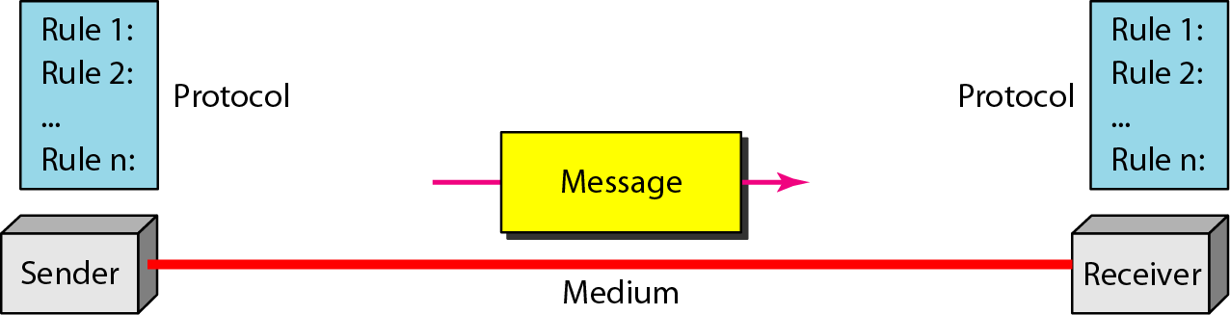
Components of Data Communication
1.Message, 2.Sender, 3.Receiver, 4.Medium and 5.Protocol
Source: Data Communications and Networking – Behrouz A. Forouzan
Notes:
The protocol defines a common set of rules and signals that computers on the network use to communicate. One of the most popular protocols for LANs is called Ethernet.
Message : It is the data to be communicated. It consists of text, numbers, pictures, sound, or video or any combination of these.
Sender : It is the device that sends the data message. It can be a computer, workstation, telephone handset, video camera.
Receiver : It is the device that receiver the message. It can be a computer, workstation, telephone, and television.
Medium : Transmission medium is the physical path by which a message travels from sender to receiver. Example it consists of twisted pair wire, co axial cable, fiber optical, laser or radio waves.
Protocol: It is a set of rules that govern data communication. Without a protocol two devices are connected but not communicated.

Slide 11
PROTOCOLS
A protocol is synonymous with rule. It consists of a set of rules that govern data communications. It determines what is communicated, how it is communicated and when it is communicated.
The key elements of a protocol are
syntax, semantics and timing

Slide 12
Elements of a Protocol
Syntax
Structure or format of the data
Indicates how to read the bits
Semantics
Interprets the meaning of the bits
Knows which fields define what action
Timing
When data should be sent and what
Speed at which data should be sent or speed at which it is being
received.

Slide 13
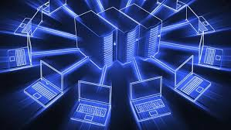
Networks
set of devices connected by communication links.
computer, printer, or any other device capable of sending and/or receiving data generated by other nodes on the network.
Network Criteria
Performance
Reliability
Security
Notes:
A network is a set of devices (often referred to as nodes)
connected by communication links. A node can be a
computer, printer, or any other device capable of sending
and/or receiving data generated by other nodes on the
network. A link can be a cable, air, optical fiber, or any
medium which can transport a signal carrying
information.
Performance
Depends on Network Elements
Measured in terms of Delay and Throughput
Reliability
Failure rate of network components
Measured in terms of availability/robustness
Security
Data protection against corruption/loss of data due to:
Errors
Malicious users

Slide 14
COMPONENTS OF COMPUTER NETWORK
Two or more computers
Cables as links between the computers
A network interfacing card(NIC) on each computer
Switches
Software called operating system(OS)

Slide 15
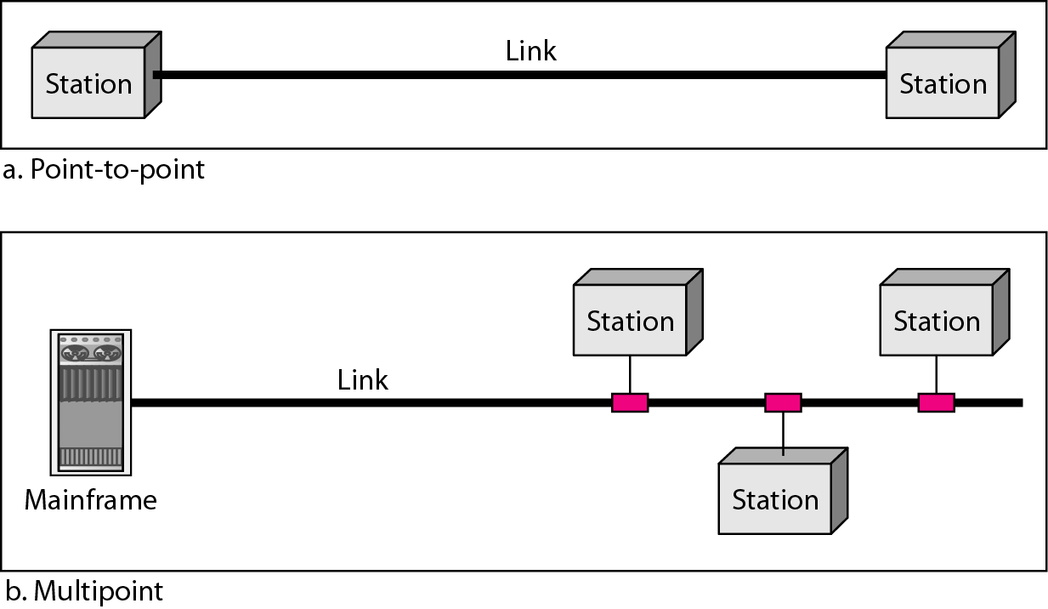
Line Configuration
Source: Data Communications and Networking – Behrouz A. Forouzan
Notes:
Physical Structures
Type of Connection
Point to Point - single transmitter and receiver
Multipoint - multiple recipients of single transmission
Physical Topology
Connection of devices
Type of transmission - unicast, mulitcast, broadcast

Slide 16
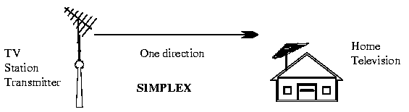
Data Flow
Simplex: Data flows in only one direction
E.g. Radio and Television broadcasts. They go from the TV station to your home television.

Slide 17

Data flow -Continued
Half duplex: Data flows in both directions but only one direction at a time on the data communication line.
Ex. Conversation on walkie-talkies

Slide 18

Data flow -Continued
Full duplex: Data flows in both directions simultaneously at the same time.
Ex. Phone communication

Slide 19
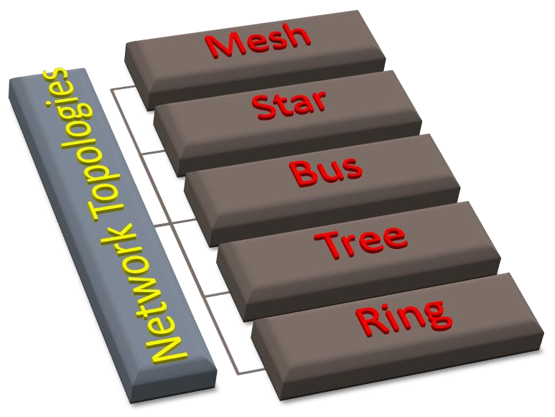
Network Topology
Physical layout of a network
The geometric representation of the relationship of all the links and linking devices (nodes) to one another.
Mesh
Star
Bus
Tree
Ring

Slide 20
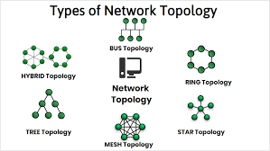
Types of Network Topology
Notes:
The arrangement of a network which comprises of nodes and connecting lines via sender and receiver is referred as network topology. The various network topologies are
a) Mesh Topology :
In mesh topology, every device is connected to another device via particular channe

Slide 21
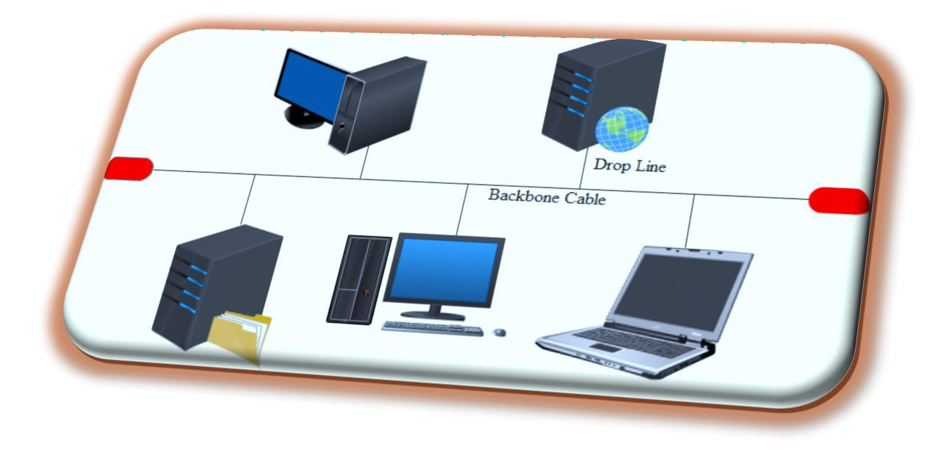
Bus Topology
All stations are attach directly to a linear transmission medium through
appropriate hardware interfacing known as a tap.
Backbone Cable
Data Flow - Full duplex
Terminator
Advantages
Ease of installation
Less cabling
Disadvantages
Difficult reconfiguration and fault isolation
Difficult to add new devices
If backbone cable fails, it can stops all transmission.

Slide 22
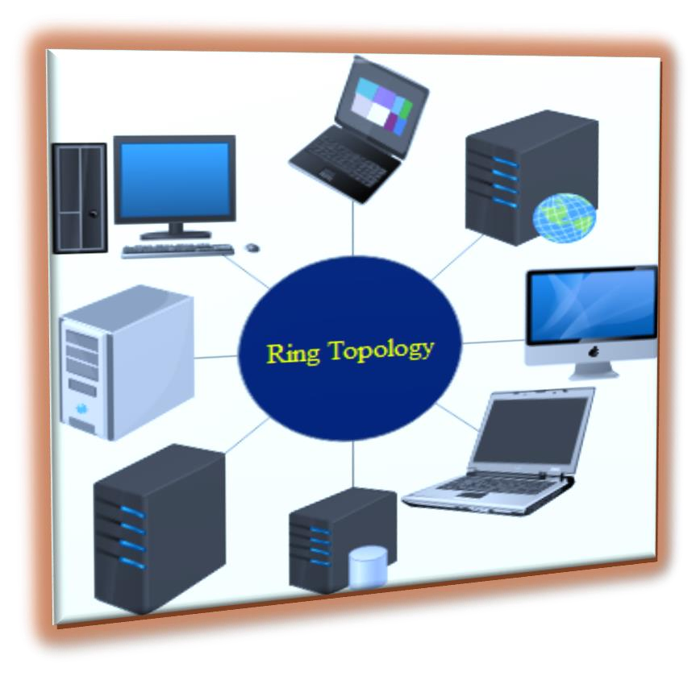
Ring Topology
Repeaters
Point-to-point links
Closed loop
Uni-directional Link
Advantages
Easy to install and reconfigure
Easy fault identificatio
Disadvantages
Unidirectional traffic
Network fails even if single link break exists

Slide 23
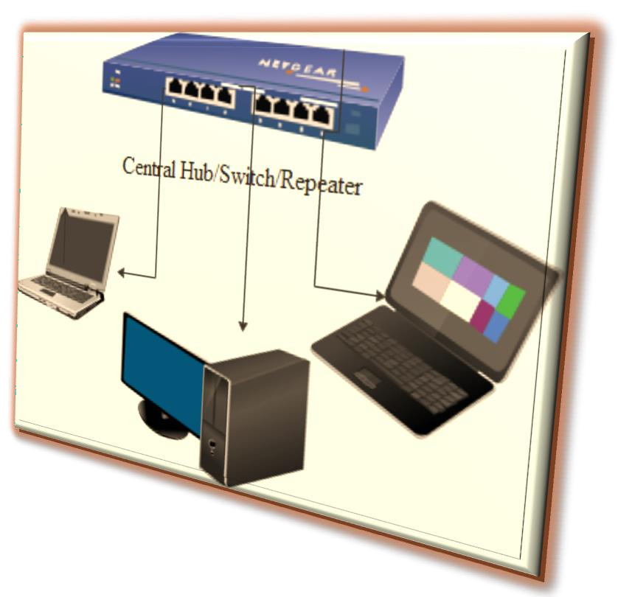
Star Topology
Central Controller
Two point to point links – Transmission/Reception
Broadcasting device
Frame switching device
Advantages
Less expensive and less cabling
Installation and configuration are easy
Robust and Easy fault identification
No disruptions
Disadvantages
Large Topology
Dependency

Slide 24
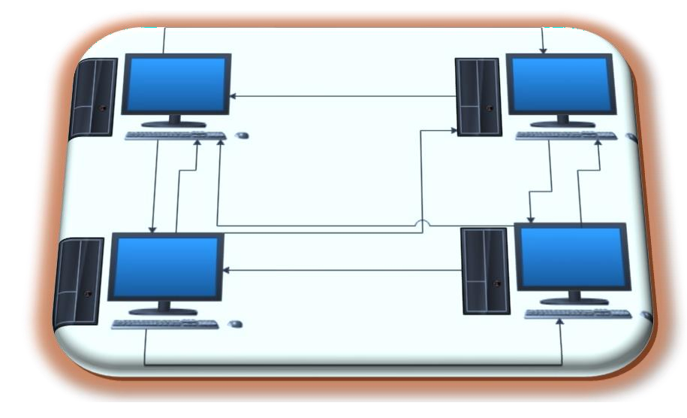
Mesh Topology
Every device has a dedicated point-to-point link to every other device
n(n-1)/2 physical channels to link n devices.
n-1 I/O ports.
Advantages
No traffic issues
Robust
Privacy and security.
Easy Fault identification and fault isolation
Disadvantages
Requires more number of cables and I/O ports
Wiring occupies more space
Hardware expensive

Slide 25
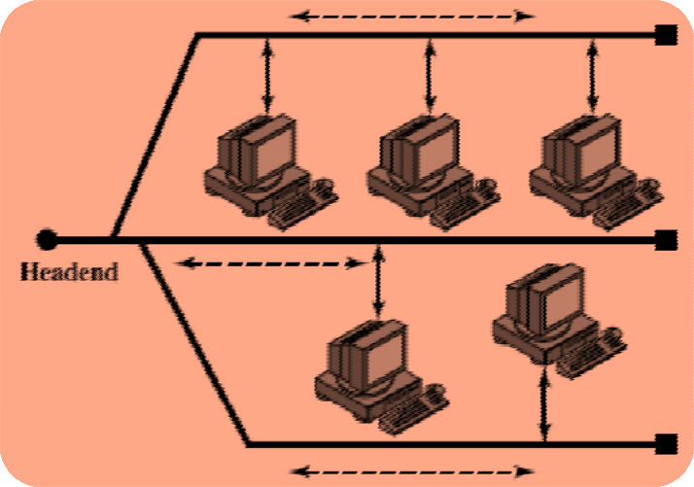
Tree Topology
Alternatively referred to as a star bus topology.
Tree topology is one of the most common network setups that is similar to a bus topology and a star topology.
A tree topology connects multiple star networks to other star networks. Below is a visual example of a simple computer setup on a network using the star topology.

Slide 26
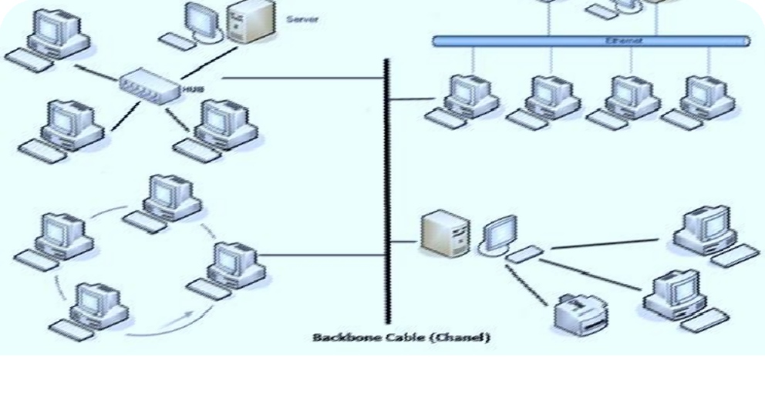

Hybrid Topology
A network which contain all type of physical structure and connected under a single backbone channel.

Slide 27
Applications of Network Topology
Mesh Topology
Telephone Regional office.
Wide Area Network – WAN
Star Topology
Star topology used in Local Area Networks(LANs).
High speed LAN often uses STAR.
Bus Topology
Most computer motherboard.
Ring Topology
Ring topologies are found in some office buildings or school
campuses.
Today high speed LANs made this topology less popular

Slide 28
Considerations for choosing topology
Money
Bus n/w may be the least expensive way to install a n/w.
Length-of cable needed
The linear bus n/w uses shorter lengths of cable.
Future growth
With star topology, expending a n/w is easily done by adding another devices.
Cable type
Most common used cable in commercial organization is twisted pair. which often used with star topologies.

Slide 29
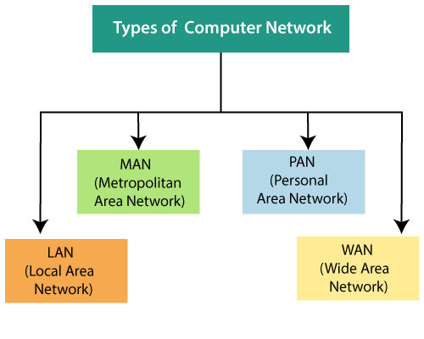
Network Categories
Notes:
Classification of Computer Networks
Computer networks are classified based on various factors.They includes:
Geographical span
Inter-connectivity
Administration
Architecture
Geographical Span
Geographically a network can be seen in one of the following categories:
It may be spanned across your table, among Bluetooth enabled devices,. Ranging not more than few meters.
It may be spanned across a whole building, including intermediate devices to connect all floors.
It may be spanned across a whole city.
It may be spanned across multiple cities or provinces.
It may be one network covering whole world.
Inter-Connectivity
Components of a network can be connected to each other differently in some fashion. By connectedness we mean either logically , physically , or both ways.
Every single device can be connected to every other device on network, making the network mesh.
All devices can be connected to a single medium but geographically disconnected, created bus like structure.
Each device is connected to its left and right peers only, creating linear structure.
All devices connected together with a single device, creating star like structure.
All devices connected arbitrarily using all previous ways to connect each other, resulting in a hybrid structure.
Administration
From an administrator’s point of view, a network can be private network which belongs a single autonomous system and cannot be accessed outside its physical or logical domain.A network can be public which is accessed by all.
Network Architecture
Computer networks can be discriminated into various types such as Client-Server,peer-to-peer or hybrid, depending upon its architecture.
There can be one or more systems acting as Server. Other being Client, requests the Server to serve requests.Server takes and processes request on behalf of Clients.
Two systems can be connected Point-to-Point, or in back-to-back fashion. They both reside at the same level and called peers.
There can be hybrid network which involves network architecture of both the above types.
Network Applications
Computer systems and peripherals are connected to form a network.They provide numerous advantages:
Resource sharing such as printers and storage devices
Exchange of information by means of e-Mails and FTP
Information sharing by using Web or Internet
Interaction with other users using dynamic web pages
IP phones
Video conferences
Parallel computing
Instant messaging

Slide 30
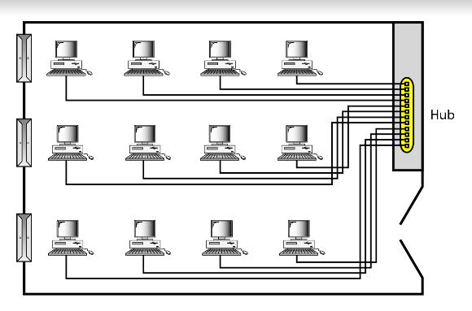
Local Area Network
Privately-owned networks within a single building or campus of up to a few kilometers in size.
The network can be categorized based on its size, its ownership, the distance it covers, and its physical architecture
LAN : 10m – Room, 100m - Building and 1km or 2 km – Campus.
An isolated LAN connecting 12 computers to a hub
Notes:
Network Hardware (Scale Perspective)
personal area networks (1m)
LAN: local area networks (10m ~ 1km)
MAN: metropolitan area networks (10km)
WAN: wide area network (100km ~ 1000km)
Internet

Slide 31
LAN
It covers a small geographical area with in a building or up to a few kilometers outside
They are widely used to connect PC with in a office.
LAN has distinguished from other networks by three characters.
size
their transmission technology
their Topology
LAN run at speeds of 10 Mbps to 100 Mbps. or (100/1000Mbps)
Different Topologies will be used for LAN Connectivity.
Bus / RING
IEEE 802.3 known as “Ethernet” - Example for LAN

Slide 32
Pros
LAN provides a cost-effective multi-user computer environment.
A LAN is suited to any type of application.
Any number of users can be accommodated.
It is flexible and growth-oriented.
Today speeds are normally 100 or 1000 Mbps.
It provide data integrity.

Slide 33
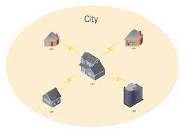
Metropolitan Area Network
A metropolitan area network, or MAN, covers a city. The best-known example of a MAN is the cable television network available in many cities.
Characteristics :Size, Transmission technology, Topology
Notes:
Computer networks can be classified into different types based on their scale of operation. They include:
LAN: A local-area network (LAN) is a computer network that spans a relatively small area. Most often, a LAN is confined to a single room, building or group of buildings, however, one LAN can be connected to other LANs over any distance via telephone lines and radio waves. Local Area Networks cover a small physical area, like a home, office, or a small group of buildings, such as a school or airport.
WAN: A computer network that spans a relatively large geographical area, generally having a radius of more than 1 km. . Typically, a WAN consists of two or more local-area networks (LANs). Computers connected to a wide-area network are often connected through public networks, such as the telephone system. They can also be connected through leased lines or satellites.
MAN: A metropolitan area network (MAN) is a network that interconnects users with computer resources in a geographic area or region larger than that covered by even a large local area network (LAN) but smaller than the area covered by a wide area network (WAN).
SAN: SAN (storage area network) is a high-speed network of storage devices that also connects those storage devices with servers. It provides block-level storage that can be accessed by the applications running on any networked servers. Storage Area Networks help attach remote computer storage devices, such as disk arrays, tape libraries, and optical jukeboxes, to servers in such a manner that that they appear to be locally attached to the operating system.
CAN: A Controller Area Network (CAN bus) is a vehicle bus standard designed to allow microcontrollers and devices to communicate with each other in applications without a host computer.
PAN: A personal area network (PAN) is a computer network used for data transmission amongst devices such as computers, telephones, tablets, personal digital assistants, fax machines and printers, that are located close to a single user.
GAN: A global area network (GAN) is a network used for supporting mobile across an arbitrary number of wireless LANs, satellite coverage areas, etc.
INTERNETWORK: Internetworking is the practice of connecting a computer network with other networks through the use of gateways that provide a common method of routing information packets between the networks. The resulting system of interconnected networks are called an internetwork, or simply an internet.
Computer networks are an integral part of our lives. It is only because of networking that telephones, televisions, radios, and the Internet are at our fingertips.
02.

Slide 34
MAN
The high speed links between LANs within a MAN are made
possible by fiber-optic connectionMAN is a bigger network covers a group of nearby offices in a city up to 10 – 20 kilometers range.
MAN supports both voice and data.
The typical example is Local Cable Network.
MAN run at speeds of 150 Mbps.
Bus Topology is used for MAN Connectivity.
The high speed links between LANs within a MAN are made
possible by fiber-optic connection
It may be a single network such as a cable TV network or it may be a means of connecting a number of LANs into a large network so that resources may be shared LAN-to-LAN as well as device-to- device.

Slide 35
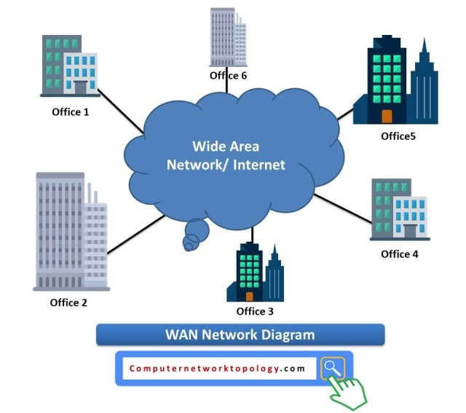
Wide Area Network
A wide area network, or WAN, spans a large geographical area, often a country or continent. It contains a collection of machines intended for running user (i.e., application) programs
Characteristics :Size, Transmission technology, Topology
100km – upto Country level , 1000km – upto continent and
10,000km – upto Planet level.( The Internet).

Slide 36
Wide Area Network
WAN covers a large geographical area , country or continent.
Hosts / Subnet - The job of the Subnet is to carry the messages from host to host.
Transmission Lines
Switching Elements ( Specialized Systems )
Packet Switched Nodes / Router
Inside the Subnet routers have a connectivity among themselves.
Store and Forward Concept
All the Topologies are applicable
Works at 100 Mbps to 1000 Mbps.

Slide 37
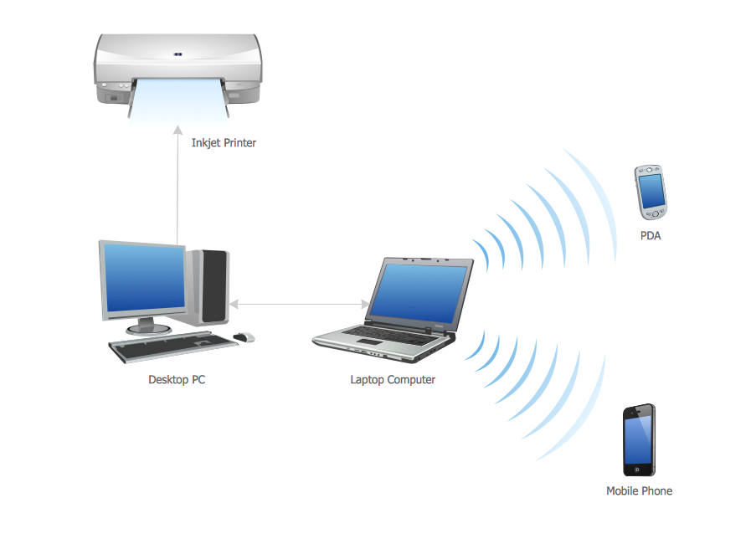
Personal Area Network
A personal area network, or PAN, is a computer network that enables communication between computer devices near a person.
Examples of wireless PAN, or WPAN, devices include cell phone headsets, wireless keyboards, wireless mice, printers, bar code scanners and game consoles

Slide 38
Characteristics of Network
Topology : The geometric arrangement of a computer system.
Protocol : The protocol defines a common set of rules and signals that computers on the network use to communicate. One of the most popular protocols for LANs is called Ethernet.
Architecture : Networks can be broadly classified as using either a peer to peer or client/server architecture.

Slide 39
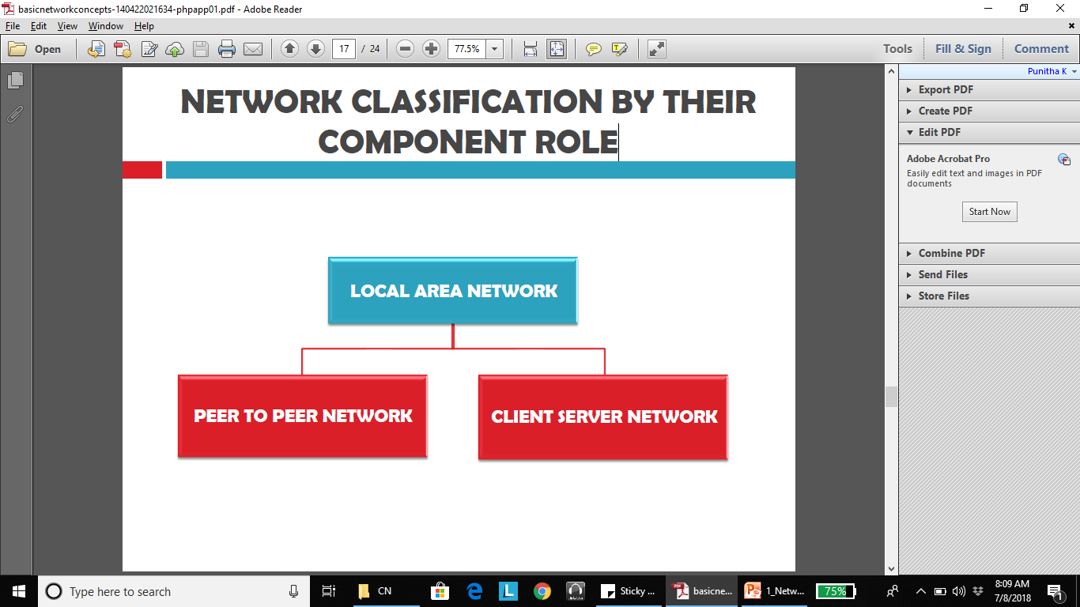
NETWORK CLASSIFICATION BY THEIR COMPONENT ROLE

Slide 40
PEER TO PEER NETWORK
In peer to peer network each computer is responsible for making its own resources available to other computers on the network.
Each computer is responsible for setting up and maintaining its own security for these resources.
Each computer is responsible for accessing the required network resources from peer to peer relationships.
This network is useful for a small network containing less than 10 computers on a single LAN. Each computer can function as both client and server and do not have a central control system.
There are no servers in peer network. Peer networks are amplified into home group.

Slide 41
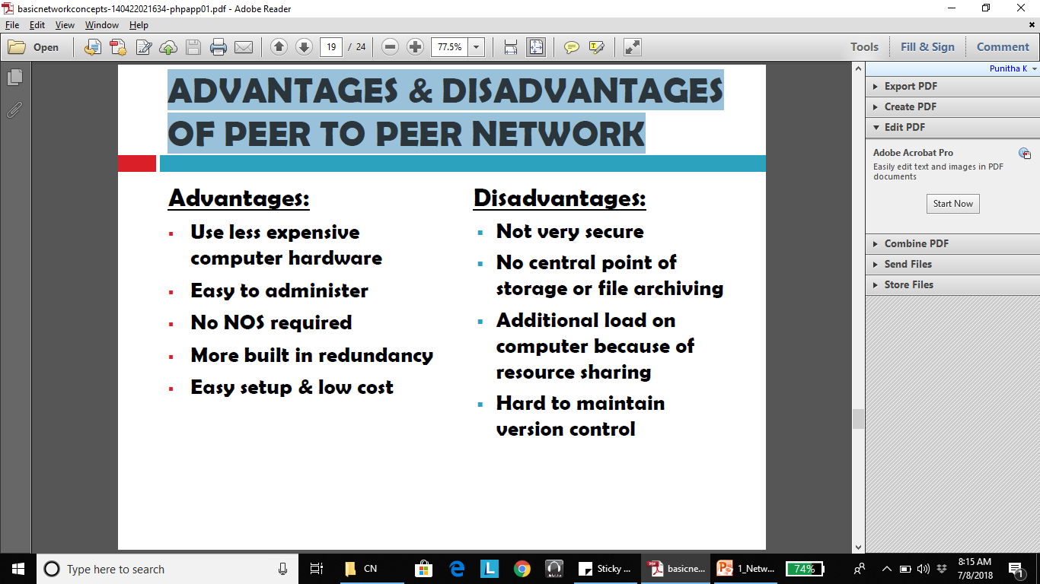
ADVANTAGES & DISADVANTAGES OF PEER TO PEER NETWORK
*NOS – Network Operating System

Slide 42
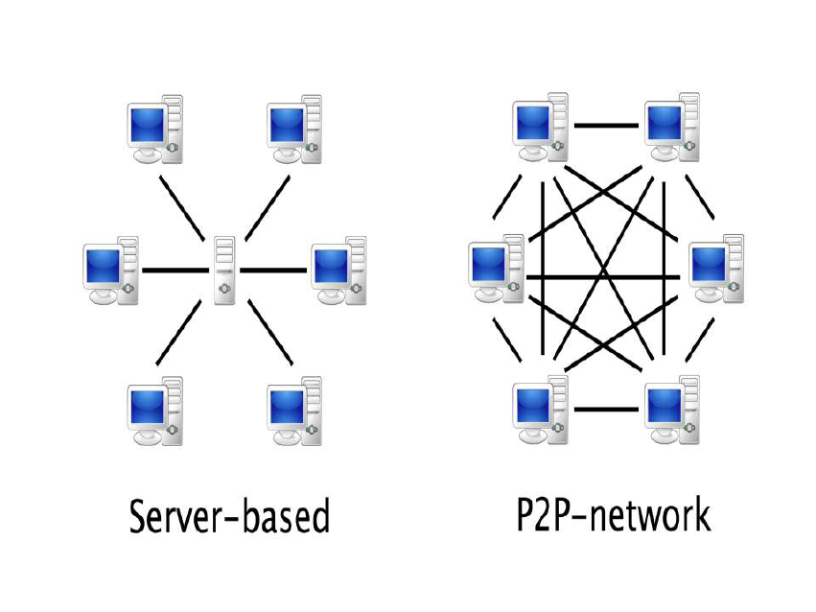

Slide 43
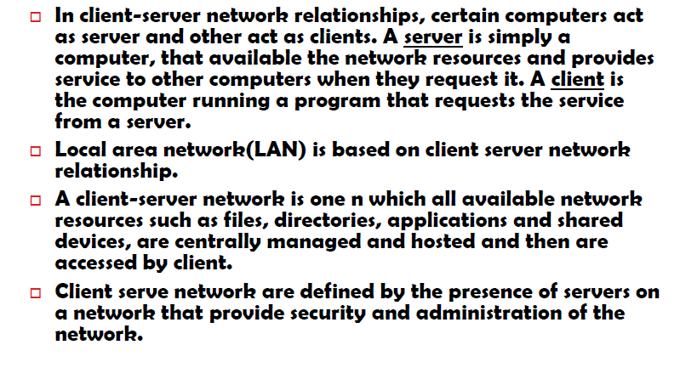

Slide 44
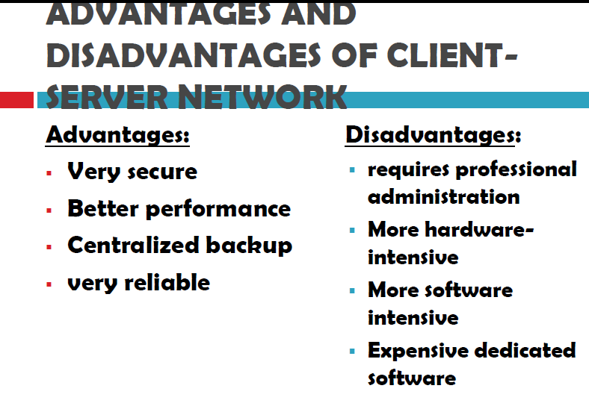

Slide 45
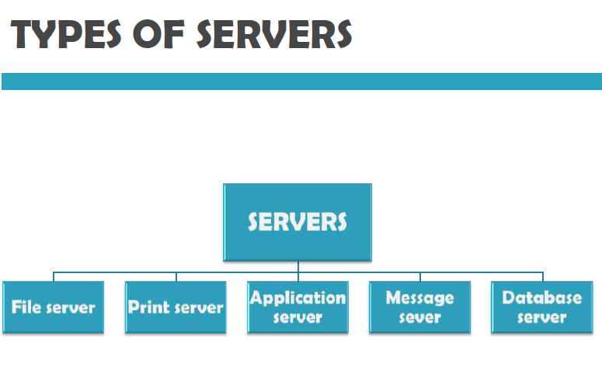

Slide 46
TYPES OF SERVERS
File server: provides services for storing, retrieving and moving data. User can read/write/exchange/manage files with help of file servers
Printer server: used for controlling and managing printing on the network. It also offers the fax service to the network users.
Application server: helps to share expensive software and additional computing power by the computers in a network.
Message server: used to co-ordinate the interaction between users, documents and applications. Data - audio,video,binary, text or graphics
Database server: It is a type of application server. It allows the uses to access the centralized strong database.

Slide 47
Network Benefits: SHARING RESOURCES
Types of resources are:
1. Hardware: A network allows users to share many hardware
devices such as printers, modems, fax machines, CD ROM, player, etc.
2. Software: sharing software resources reduces the cost of software installation, saves space on hard disk.

Slide 48
OTHER BENEFITS OF COMPUTER NETWORK
Increased speed
Reduced cost
Improved security
Centralized software managements
Electronic mail
Flexible access

Slide 49
Pros & Cons of Networks
Increased speed
Reduced cost
Improved security
Centralized software managements
Electronic mail
Flexible access
High cost of installation
Requires time for administration
Failure of server
Cable/Media faults

Slide 50
Applications of Networks:
Electronic messaging. (E-Mail)
Electronic data Interchange. ( E-Com.).
Teleconferencing.
Cellular Telephone.
Cable TV.
On-line Marketing , Sales, ticket reservations (boats, hotels, theaters)
Financial Services. (E- Cash).
Manufacturing.
Information Services.

Slide 51

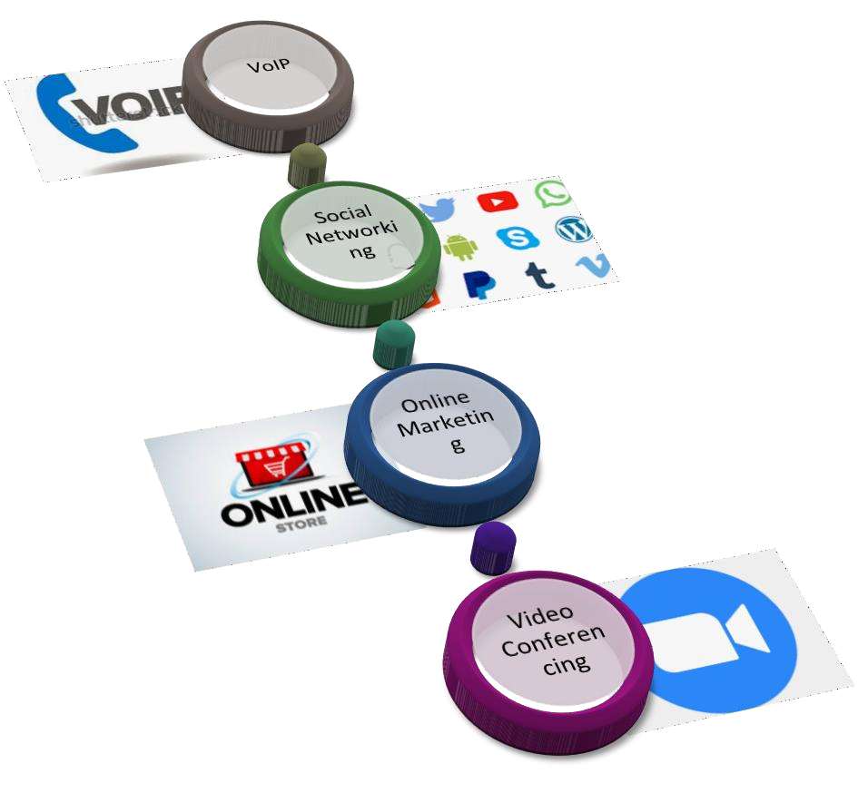
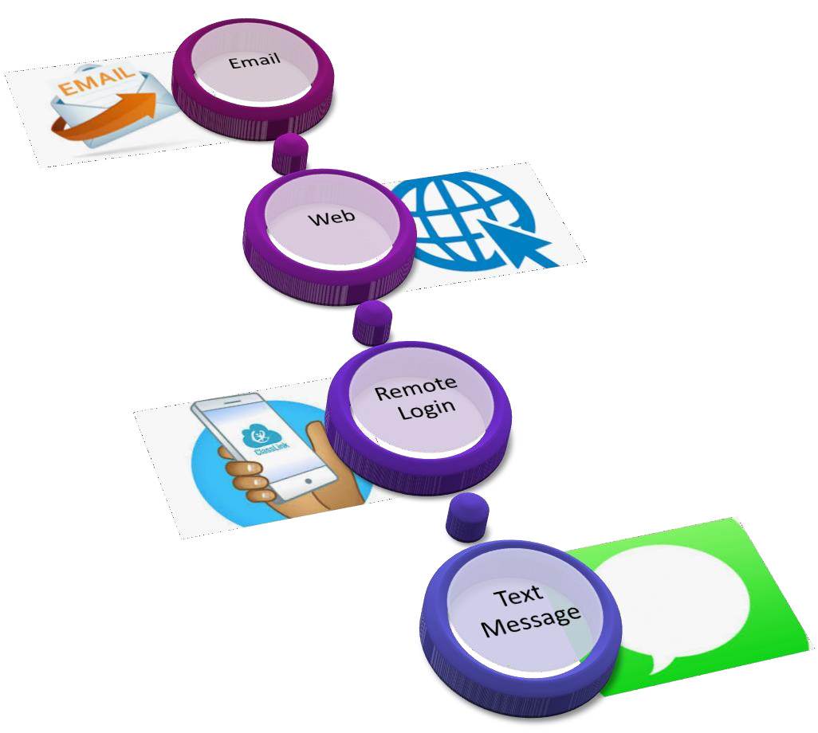
Applications of Networks

Slide 52
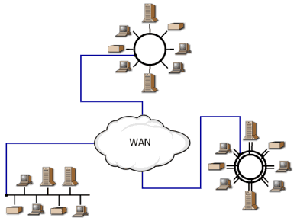
Internetwork
An Internetwork is a collection of independent remote networks, LANs and WANs, and their connecting devices. They function together as one large network sharing connectivity resources.
Internet : A global computer network providing a variety of information and communication facilities, consisting of interconnected networks using standardized communication protocols

Slide 53
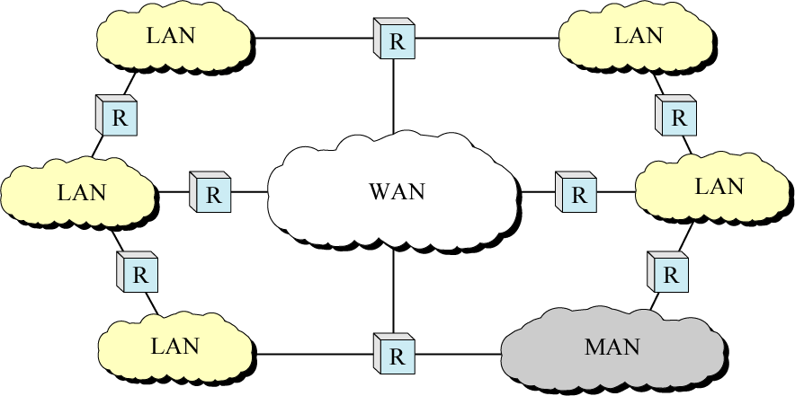
Internetwork (Internet)

Slide 54
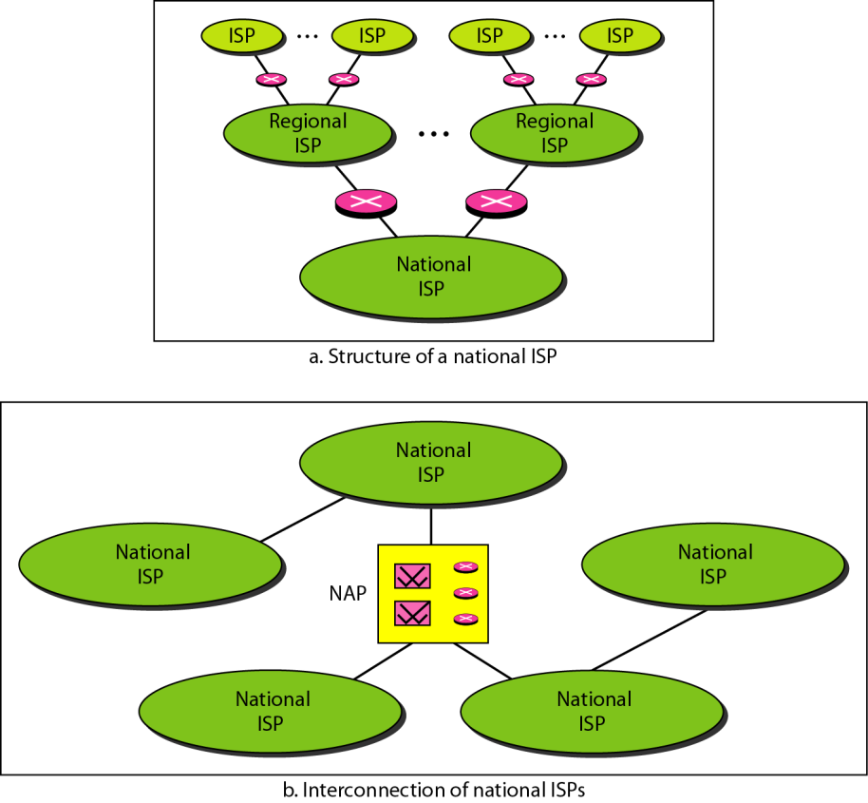
Hierarchical Organization of Internet
Notes:
An Internet Service Provider (ISP) is a company that provides Internet access by using copper, fiber, or even satellite communications to the customer.
Different types of ISP connections
ISPs use a range of technologies to enable customers' connection to their network. The most common types of internet connections include:
DSL (digital subscriber line)
cable broadband
fibre optic broadband
wireless or Wi-Fi broadband
satellite and mobile broadband
dedicated leased line

